Slide 1
Appreciation of English and American Literature
Week 5 – The Birth of the Novel

Slide 2
What is ‘a novel?’
What makes a novel different from earlier forms of writing?
When did they begin, and why did they begin?
Do they have a particular style or content?
How long are they?
What is their purpose?

Slide 3
Article Reading – Discussion
What did the article on ‘The Rise of the Novel’ say?
How was Robinson Crusoe different, and why?
What happened with ‘novels’ in the rest of the 18th century?

Slide 4
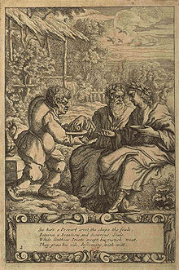
Ancient ‘Novels’
There is a genre of ‘Greek Novels’ (but written in the Roman era, 1st Century to 4th Century AD)
An example is The Aesop Romance, a fictional biography about Aesop’s life, from being a slave, to getting a gift of storytelling from a Goddess, and then travelling and telling his fables.

Slide 5
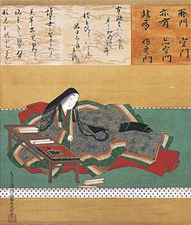
Ancient ‘Novels’
There were also Byzantine Romances in the 12th Century in Constantinople, which used the structure of ancient Greek novels.
The Tale of Genji is a Japanese ‘novel’ – sometimes called the first ever novel – from the 11th Century, about the life of a ‘fictional’ prince called Genji in the Japanese court. It was written by a woman at court, has romance and realism, a darkening tone throughout, and many poems.

Slide 6
The Chinese ‘Classic’ ‘Novels’
Romance of the Three Kingdoms (14th Century, 800,000 words)
Journey to the West (16th Century)
Water Margins (16th Century?)
Dream of the Red Chamber (18th Century, 845,000 words)
They all have 100 chapters or more and tell fictionalised accounts, involving many characters, often in quite separate episodes.

Slide 7
Novel Length
A novel is considered to be more than 40,000 words
(but modern publishers typically require 80,000 words)
A novella is considered to be from 7,500 to 40,000 words
A short story is less than 7,500 words
The Lord of the Rings – 470,000 words
Robinson Crusoe – 121,000 words
Harry Potter and the Philosopher’s Stone – 77,000
(All Seven Harry Potter Books – 1,084,000)
The Pilgrim’s Progress – 57,000 words
The Great Gatsby – 47,000 words

Slide 8
‘The Novel’ as a European and English form of literature

Slide 9
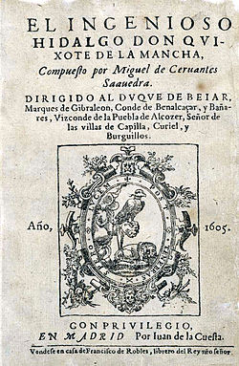
The Ingenious Nobleman Sir Quixote of La Mancha
Known commonly as Don Quixote.
Written in Spain, published 1605 – 1615
The story of a noble who has read so many ‘romances’ that he goes crazy and goes on a journey to be a romantic, heroic knight.

Slide 10
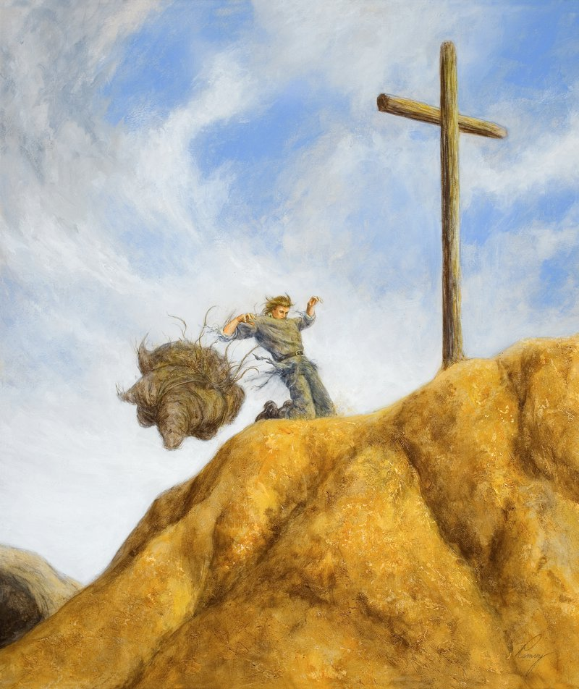
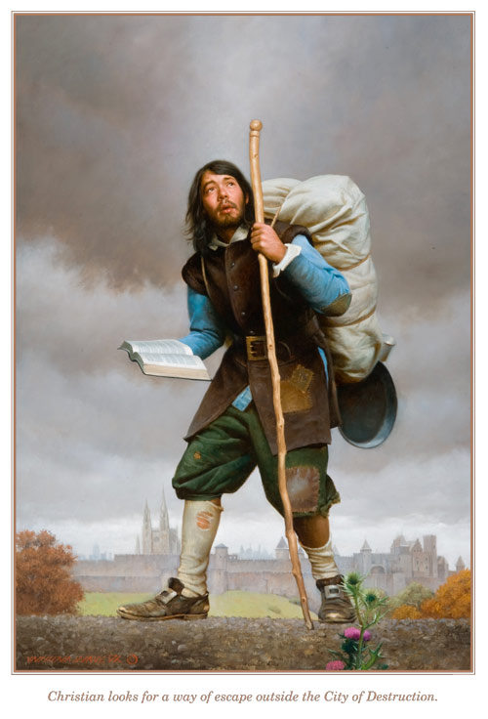
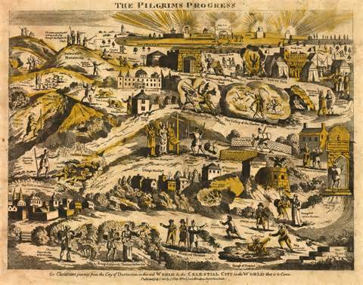
The Pilgrim's Progress from This World, to That Which Is to Come
A contender for the first ‘novel’ written in English.

Slide 11
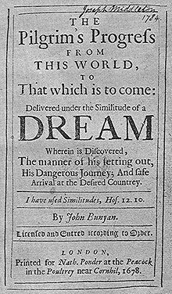
The Pilgrim's Progress from This World, to That Which Is to Come
Known as Pilgrim’s Progress.
Written by John Bunyan in 1678, while in Prison for preaching.
A man called Christian goes on a journey, meets characters, and crosses difficult obstacles – allegories for his spiritual journey. He finally reaches the Celestial City.
For more than two centuries it was one of the most widely read books in the world.

Slide 12
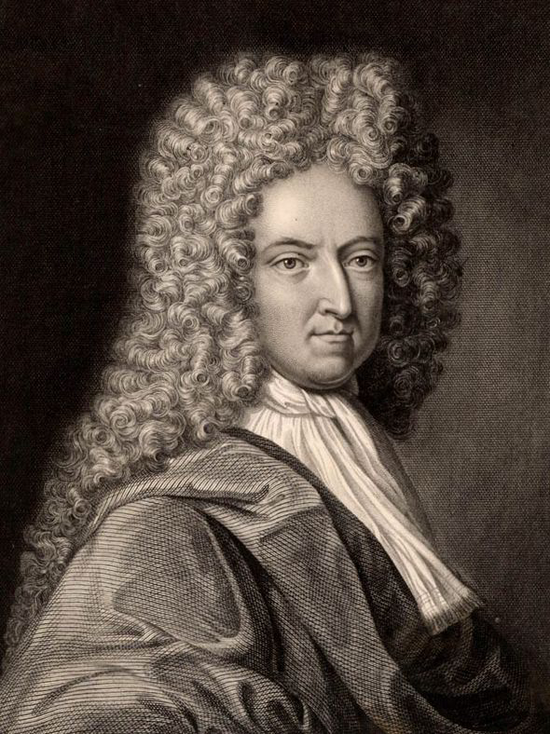
Daniel Defoe (1660 -1731)
A trader, ‘novelist’, journalist, periodical writer, and political pamphleteer – he was sent to jail for writing critical pamphlets.
In 1719 he wrote Robinson Crusoe, at the age of almost 60, followed by other novels.
It seems likely to have been influenced by the true account of Alexander Selkirk who was castaway on an island for 4 years.

Slide 13
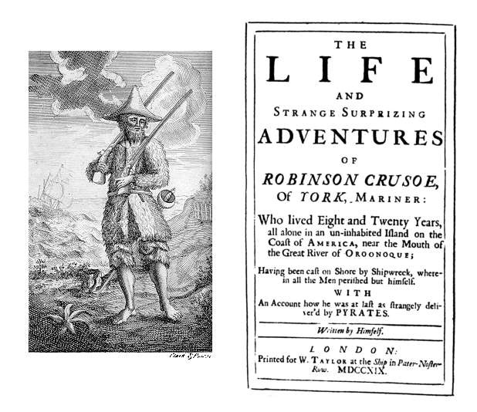
The story contains many elements that were quite original in fictional writing – and have led to it being described as the first ‘novel’.

Slide 14
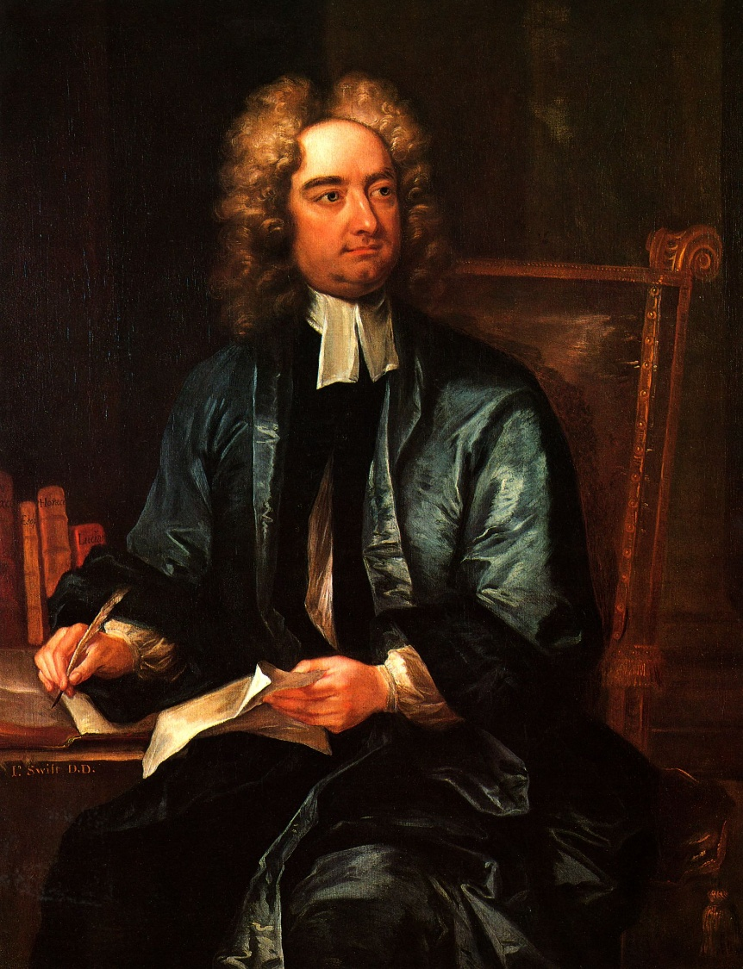
Jonathan Swift (1667 – 1745)
A very influential essayist, novelist, poet, political writer and priest.
Wrote Gulliver’s Travels (1726), a satire of adventure and shipwreck stories, politics and society.
Gulliver travels to strange lands, where he is a giant; is tiny; finds a flying city; and talking horses, etc.

Slide 15
The Life and Opinions of Tristram Shandy, Gentleman – ‘Tristram Shandy’
Written by Laurence Sterne and published between 1759-1767
It is a fictional biography of Tristram, is quite rudely comical, and has a satirical style.
Tristram doesn’t do much, but talks a lot about many philosophical things.

Slide 16
Different Ideas of What a Novel Is:
Not a ‘Romance’ = not fantastical. Instead, it is realistic.
Not an Anthology = not a collection of different stories put together.
Not an Allegory = not wholly a metaphor representing other meanings.
It must be wholly original = not an old story, retold and added to.
It must have unity in its structure and be a cohesive whole.
It must contain characters and their inner-selves, which must be revealed by character arcs, narrative and plot points.
Ian Watt wrote The Rise of the Novel: Studies in Defoe, Richardson and Fielding (1957), which argued that Robinson Crusoe was the first proper novel.

Slide 17
Robinson Crusoe Reading:
Excerpts from Chapter 2 and Chapter 3
What is the style of the English? How would you describe it?
How is it narrated? Who is the narrator?
What can we learn about the man, Robinson Crusoe?
What techniques are used to describe the action?

Slide 18
Robinson Crusoe Reading:
Excerpts from Chapter 7 and Chapter 8
What happens in these excerpts?
How are the world and events portrayed?
How is Robinson Crusoe’s inner life portrayed?
What techniques are used to describe the action?

Slide 19
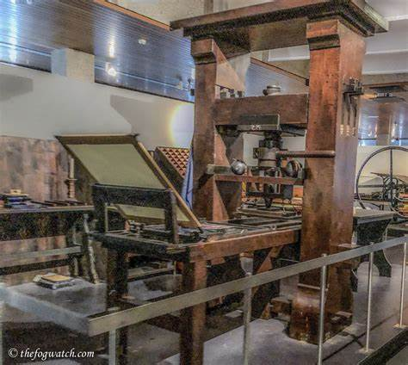
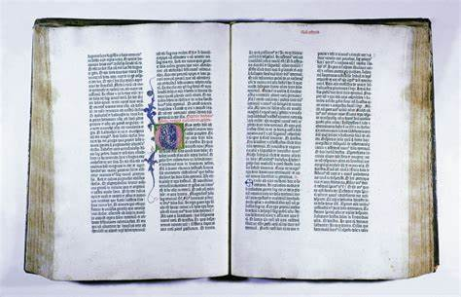
Why did the novel appear as a form of literature?
Lots has been written about this question, and about the cultural changes in England and northern Europe.
The Gutenberg printing press was invented, and in 1455 printed the first ‘Gutenberg Bibles.’
When Martin Luther began the Protestant Reformation in the 16th century, people began to have Bibles to read, translated into their own languages.

Slide 20
Why did the novel appear as a form of literature?
Daniel Defoe – and John Bunyan – were Dissenters / Non-conformists, who went to independent churches.
Protestantism put the emphasis back onto personal faith in God (not via the Catholic Church).
It has been argued that this led to key changes in culture: freedom of inquiry, personal responsibility, and more – such as what early sociologist Max Weber called ‘The Protestant Work Ethic.’
The changes in faith, thought, and behaviour can be seen in literature.

Slide 21
Robinson Crusoe Reading:
Excerpts from Chapter 14 and Chapter 19
How is the action described?
What views does Robinson Crusoe have about civilisation and culture?
How does the ending of the story connect to the themes we’ve seen throughout?

Slide 22
Writing Practice – academic or creative
What made Robinson Crusoe distinct as literature?
Try to answer with an academic essay style.
Or spend some more time doing creative writing:
- An ‘Eagle’ poem.
- A heroic/knightly poem, with alliteration, like in Beowulf or Sir Gawain and the Green Knight.
- Some lines of Iambic pentameter (unstress-stress x5), like Shakespeare used.

Slide 23
Homework Reading
Please read the excerpts from Pride and Prejudice, by Jane Austen, and also the poem Peter Grimes, by George Crabbe.

